Slide 1
An Empirical Study on Regular Expression Bugs
Peipei Wang Chris Brown
Jamie A. Jennings Kathryn T. Stolee
North Carolina State University
pwang7@ncsu.edu dcbrow10@ncsu.edu
jjennings@ncsu.edu ktstolee@ncsu.edu
Notes:
Introduction myself----I am Peipei from NC State
present you our study on regular expression bugs

Slide 2
Some people, when confronted with a problem, think, “I know, I’ll use regular expressions.” Now they have two problems.
-Jamie Zawinski
Notes:
http://regex.info/blog/2006-09-15/247 Jamie Zawinski (an early Netscape engineer)
this is a famous quotation about using regular expression. It exactly expresses my experience of using it.
And you have used regular expression, you may agree with me on that regular expression is hard to read and write. It is error-prone and difficult to test.
So there are a lot of efforts in dealing with regular expression problems. For example, researchers have been focused on regex comprehension issues, performance issues, security vulnerabilities, testing coverage, its reusability on other languages.
Each problem is a separate piece, we do not know how often each problem appears, which one is more important, and what is still in the box. And most importantly, how to fix them
We want to uncover the nature of the issues that relate to regular expressions, and in particular, the nature of the issues that developers end up addressing.
that’s why we have this paper and conduct the study on regular expression bugs.
//Knowledge about the frequency of various types of regular expression issues, such as those related to performance, API misuse, and code smells, can guide testing, inform documentation writers, and motivate //refactoring efforts.
//
//which regular expression format style is more understandable, whether regular expression can be reused and ported across language boundaries, the performance of executing a regex, the ReDoS security attack, and
The motivation----looks like a No to use regex
we love it, and hate it. But we cannot get rid of it--------why this paper; less is more
Succinct for pattern matching.
Less code and flexible
Hard to make it correct.
Complicated to understand.
Difficult to test and debug.
There are various types of bugs in software systems, some are easy, some are not easy. For the hard ones, people have dedicated their time studying the bug to understand why it happens, how it happens, and how to fix it. r
Regular expression is one of the hard ones, so we did an empirical study to answer those questions.

Slide 3
Contributions
Identify root causes and manifestations of bugs.
Describe approaches to fix the bugs.
A taxonomy of regex-related bugs and fixes.
Notes:
In this study, we identified root causes and manifestations of the bugs. We described approaches to fix the bugs. Based on this, we created a taxonomy of regex-related bugs and fixes.

Slide 4
Search title and description:
“regular expression”
-- or --
“regex”
Filter by language:
Java
JavaScript
Python
Filter by PR status:
merged
Identify regex bugs:
Change to regex or regex API
Automatic
Manual
350
PRs
Notes:
We chose GitHub pull requests as our study object because pull requests usually combine both the problem and the fix.
From the GitHub, we selected all pull requests from Apache, Mozilla, Facebook and Google repositories.
And then we filtered out the pull requests which do not involve regex bugs by searching in the pull request title, body, and comments for keyword regex or regular expression
After that filtered based on the top 3 most popular languages on GitHub
We also filtered pull requests according to their merge status. Only merged pull requests are selected because merged ones not only shows developers’ interest to solve the problem but also provides accepted patch to fix the problem.
In the next step, we identified the regex-related pull requests and made sure there is a code change to a regex or a regex API.
With this process we ended up with 350 merged regex-related PRs
The first few steps are automatic, but identifying regex-related pull requests are manual.
//
the pull request which are related to a regex bugs.
From the repositories of these four organizations we (click) // contain regex/regular expression. this is the primary automatic selection of pull requests,
searched for regex-related using keywords in the title and description (click)
filtered based on the top 3 most popular languages (click)
make sure there is a code change to a regex or the regex API (click)
and ended up with 350 merged regex-related PRs

Slide 5
How to analyze the PRs?
Notes:
For the 350 pull requests, we manually identify their root cause and manifestation for each of them. Here is an example

Slide 6
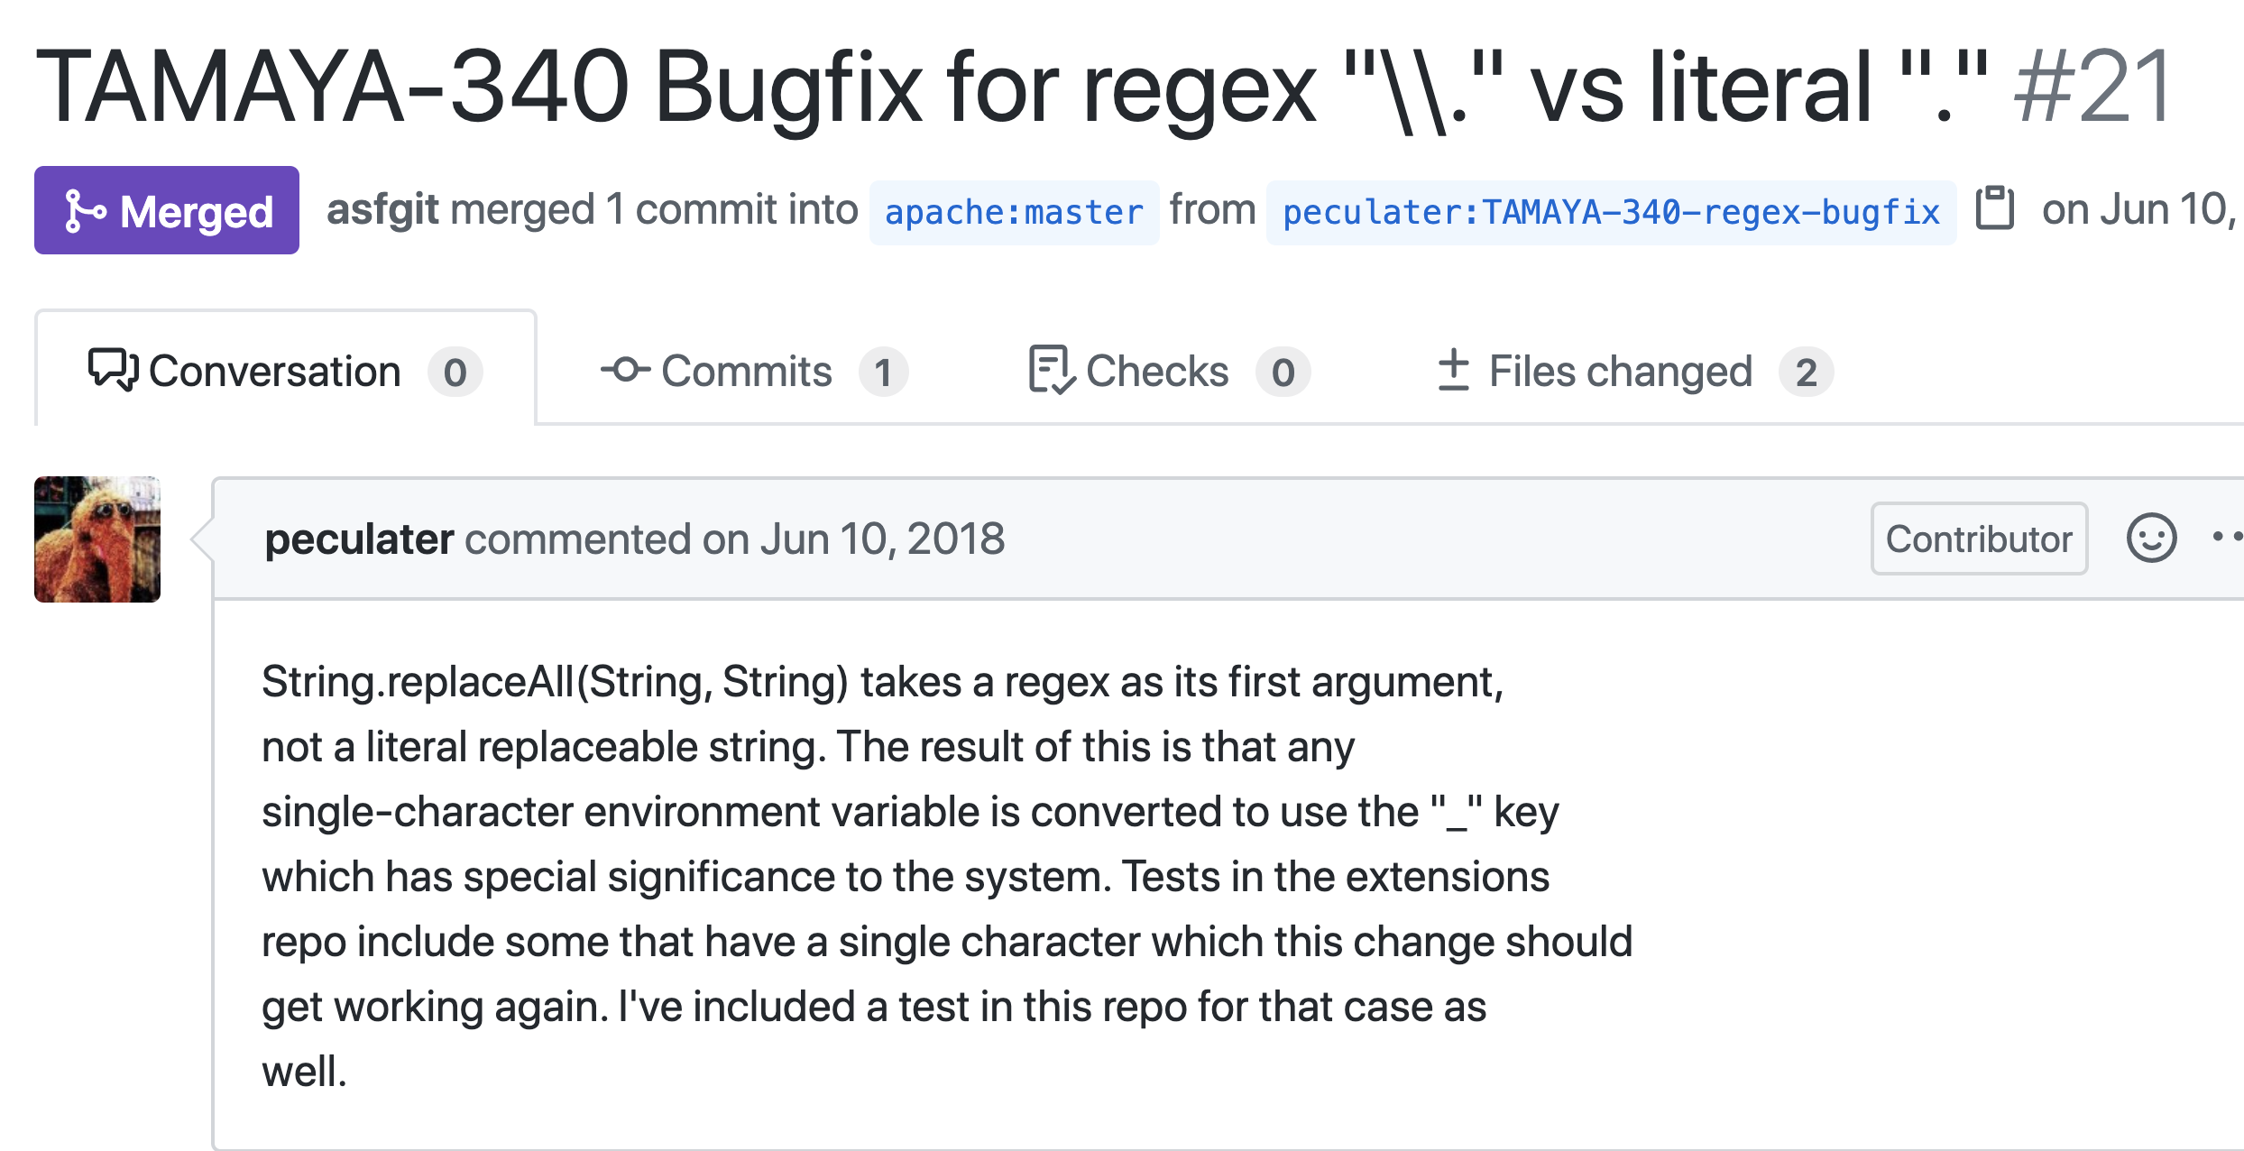
Notes:
//How we We look at bugs through the lens of pull requests. (click) This is so we can see the problem description as well as the solution.
//those pull request have 2 requirement:
We look at the PR title description to understand what happened. In this example dot is a wildcard character in regex and it matches any single character.
click
if you pass the literal dot to the replaceAll function, it would be treated as the wildcard dot in regex. As a result, all single characters are converted.
In addition to the PR title and description, here is a reference to JIRA bug report which can provide us with more information
https://github.com/apache/incubator-tamaya/pull/21

Slide 7
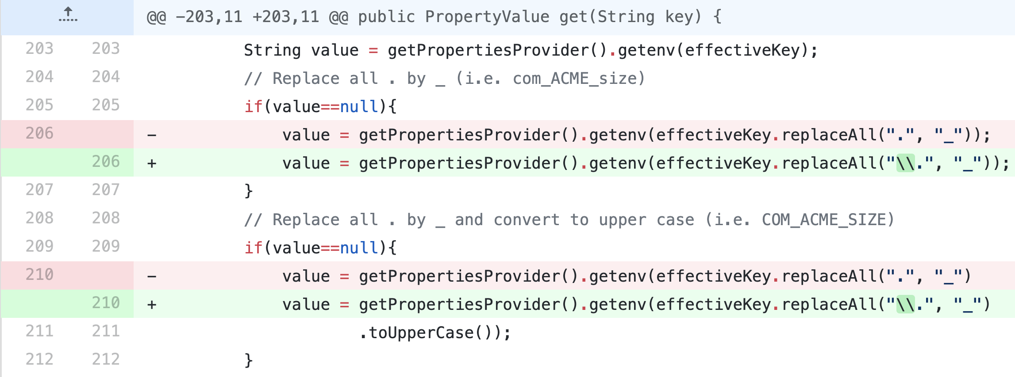
Notes:
We also look at the code changes in the PR. (click) in this example, the fix is pretty easy, Just add two bach slashes before the dot, and it will tell the regex parser that here is a literal dot and not a wildcard.
// we are interested in the fix in addition to the problem, the benefit of merged pull requests is that we know what are the problems developers are interested in fixing.
Here (click) we see a regular expression is removed (click).
We know the regular expression was removed because it is unused; that information is based on the discussion. This is the root cause.
We know the issue was fixed by removing the regex. This is the fix process.

Slide 8
What taxonomy emerged?
Notes:
We used open card sorting with two raters to identify categories of root causes and manifestations.

Slide 9
Incorrect Behavior
Compile Error
Regular Expression Itself
Design/Code Smell
Incorrect Computation
Root Causes
Regex API
Manifestations
Design/Code Smell
New Feature
Other Code
Bad Smell
Other
Notes:
Three root causes emerged. (click)
These are the regular expression itself, the Regex API, and Other Code.
Each root cause manifested in two or three different ways. (click)
Notice that each group has a bad smell as its manifestation. each bad smell can be either a code smells or a design smell
Code smells are usually not bugs; //they are not technically incorrect and do not prevent the program from functioning.
Instead, they indicate weaknesses in the software that may impact software quality, or increase the risk of bugs or failures in the future.
such as duplicated code, long function, unused variables. They are all bad smells.
In the next few slides, I will give several examples to illustrate it.
slow down development
Smells are certain structures in the code that indicate violation of fundamental design principles and negatively impact design quality
Code smells are usually not bugs; they are not technically incorrect and do not prevent the program from functioning. Instead, they indicate weaknesses in design that may slow down development or increase the risk of bugs or failures in the future.
In computer programming, a code smell is any characteristic in the source code of a program that possibly indicates a deeper problem.^{[1][2]} Determining what is and is not a code smell is subjective, and varies by language, developer, and development methodology.

Slide 10
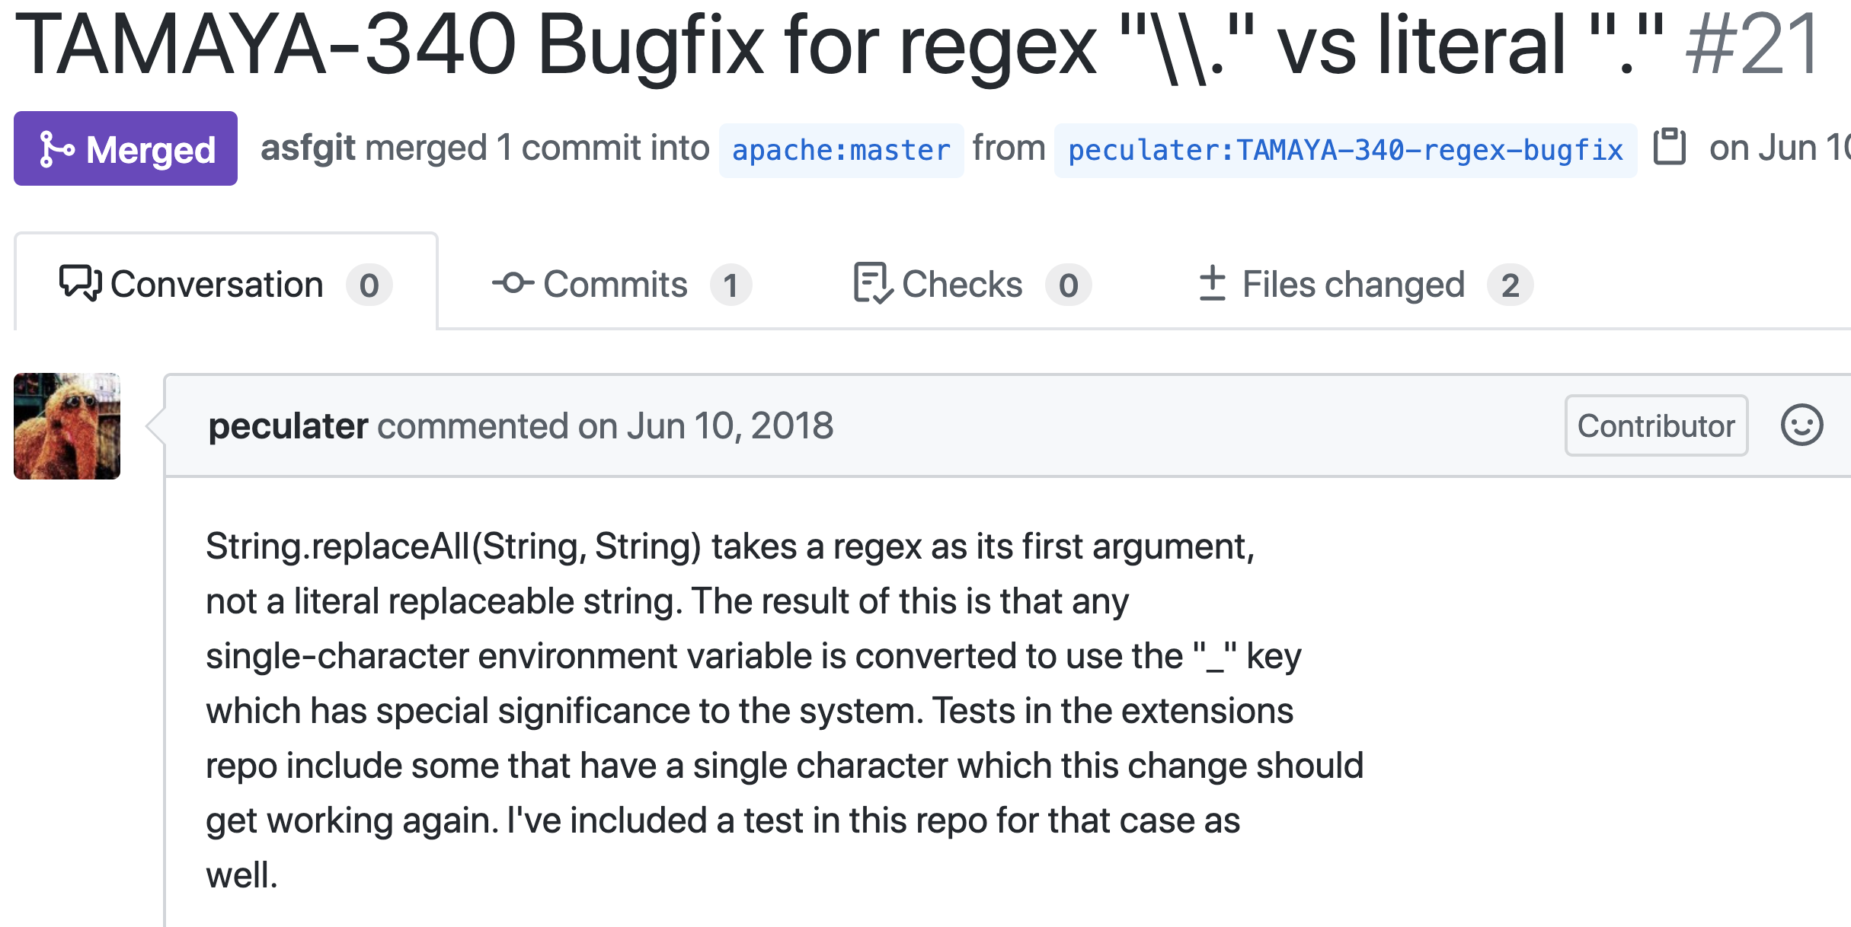
Incorrect Behavior
Regular Expression Itself
Compile Error
Design/Code Smell
Notes:
Here is the example we have just discussed.
From the description (click) we can see that the root cause is the regular expression itself (click).
Since unwanted characters are converted by the regex, it falls under the category of the incorrect behavior
https://github.com/mozilla/feedthefox/pull/43
https://github.com/apache/incubator-tamaya/pull/21

Slide 11
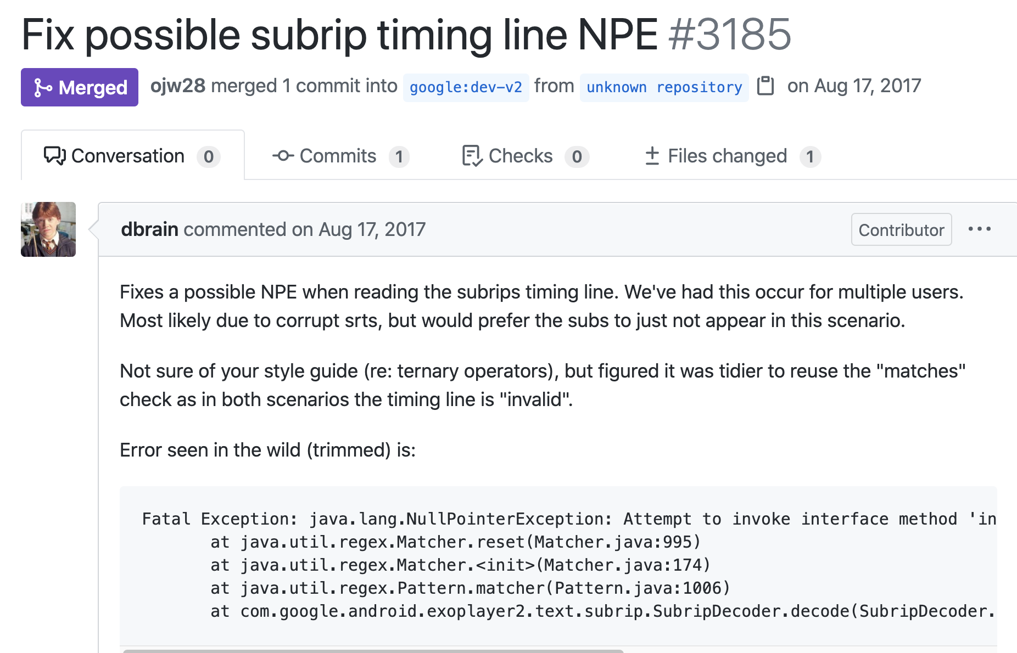
Incorrect Computation
Regex API
Design/Code Smell
Code Smell
Exception Handling
java.lang.NullPointerException
Notes:
Here is another example. The problem in this PR is the NullPointerException because Null variable is passed into regex API function
So the root cause is Regex API. Since the problem lies in how to write the code, it is a code smell. Specifically, it is a type of code smell of handling exceptions.
https://github.com/google/ExoPlayer/pull/3185

Slide 12
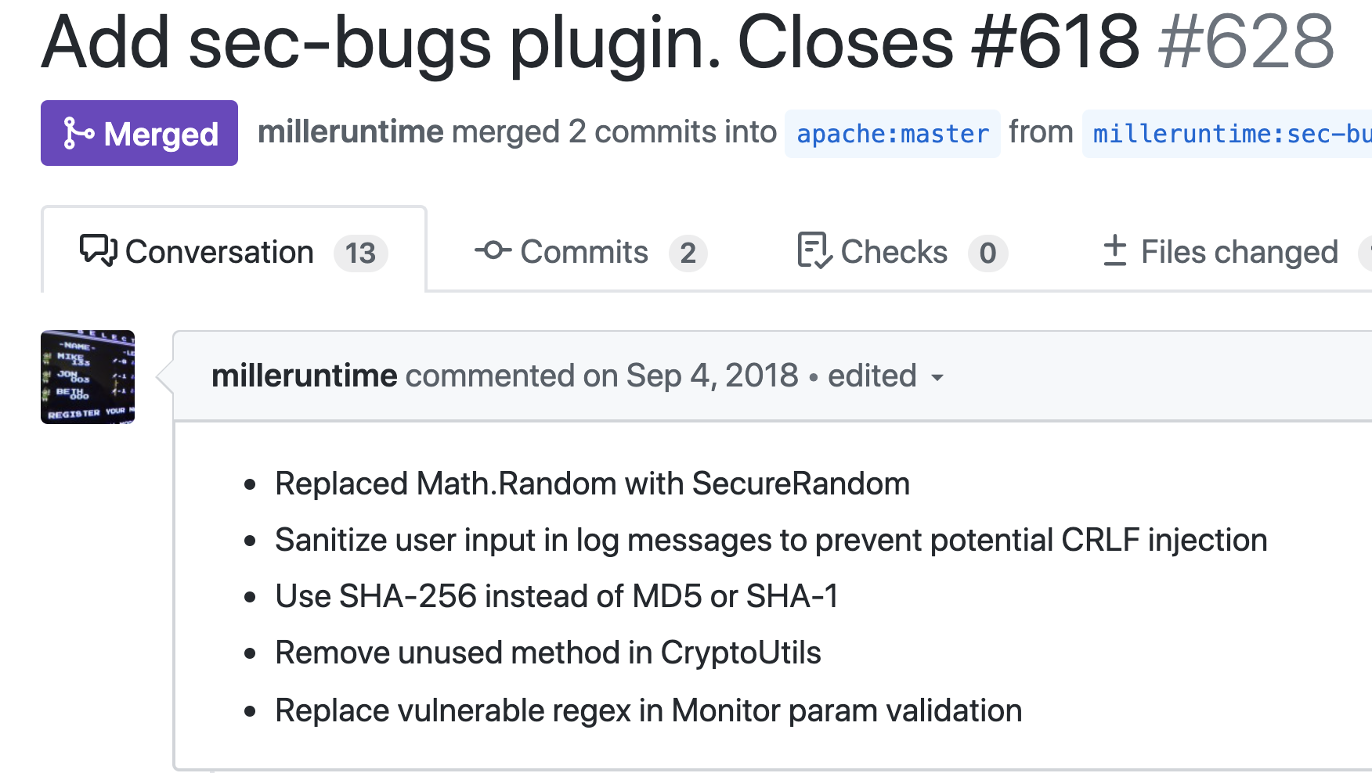
New Feature
Other Code
Bad Smell
Other
Notes:
This is our third example
Here, the issue is not with the regex, but a regex is part of the solution, thus it is regex-related. The issue is that the user input in th log message is not sanitized. (click) so the root cause is other code.
Since this is adding a new feature, input sanitization, the manifestation is a requirement that means a new feature is needed. (click)
https://github.com/apache/accumulo/pull/628

Slide 13
Incorrect Behavior
Regular Expression Itself
Compile Error
Design/Code Smell
Code Smell
Performance issues
Notes:
Sometimes, one PR contains more than one regex issue.
This example contains another regex problem.
When the complexity of a regex is not linear, it is vulnerable to ReDoS (regular expression denial of service) attack. To solve this problem, a different regex is used.
So the root cause of this problem is still regex itself. The manifestation is still a smell.
To be specific, it is a code smell related to regex performance issues.
https://github.com/apache/accumulo/pull/628

Slide 14
What did we learn?
Notes:
So, after we analyzed the pull requests and built the taxonomy of root causes and manifestions,
what have we learned from this study?

Slide 15
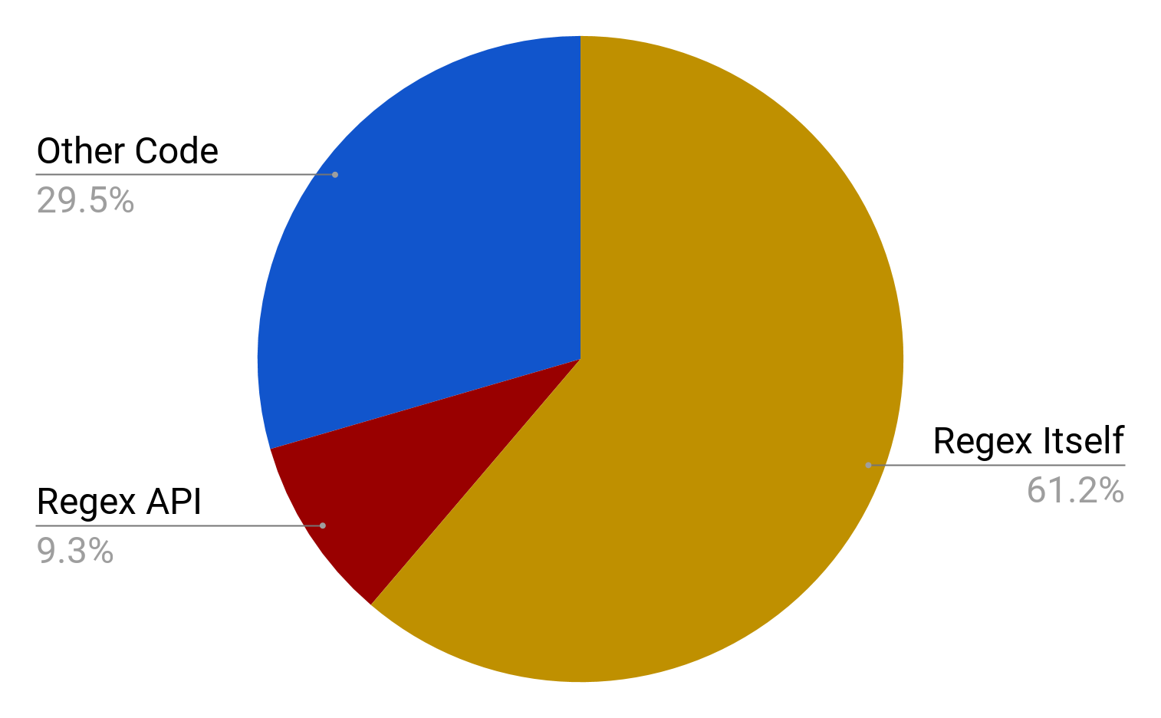
Notes:
The first finding is that Most of the issues were related to the regex itself.
From the pie chart on this slide, we can see 60% of regex bugs we studied are caused by regular expression itself. Another 9% are caused by regex APi, and 30% of the root causes are other code, not caused by regex or regex API.

Slide 16
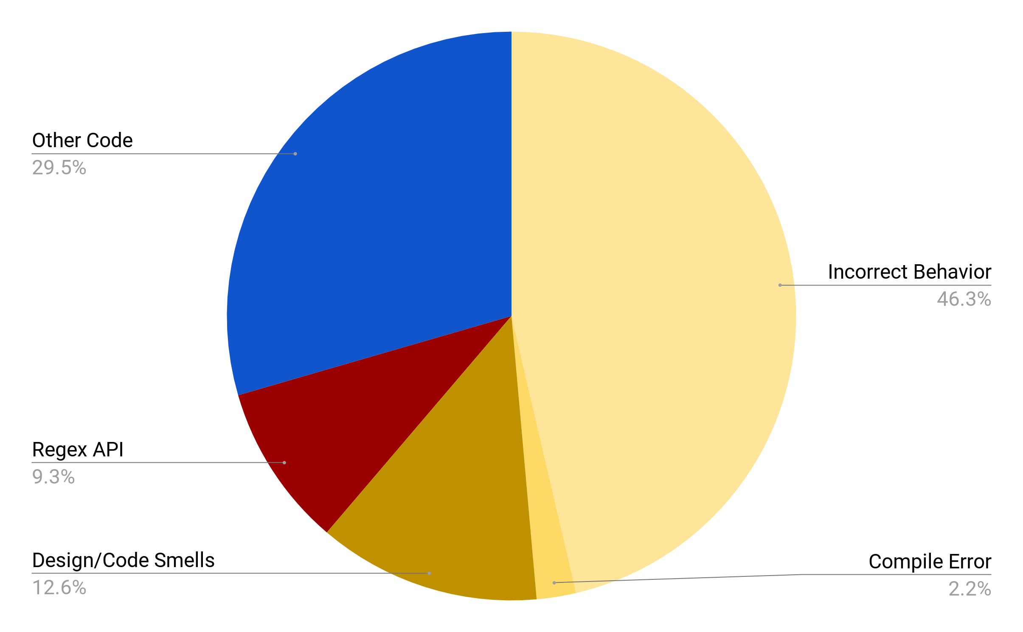
Notes:
If we zoom in, we can also see that the most common issue caused by regex itself is the incorrect regex behavior, manifested in 46% of the studied regex bugs.

Slide 17
Incorrect Behavior (165 Bugs, 46%)
Rejecting valid strings | 102 (61.8%)
Accepting invalid strings | 36 (21.8%)
Both of the above | 17 (10.3%)
Others | 10 ( 6.1%)
Regexes tend to be too restrictive.
Notes:
If we look at incorrect behavior even closer, we find the most common issue overall across all root causes and manifestations is rejecting valid strings. (click) This is nearly three times as common as accepting invalid strings, indicating that developers tend to write overly-restrictive regexes
(click) Regexes tend to be too restrictive. So during regex testing, we should probably should focus more on strings outside the regex scope, because those strings are more likely to cause incorrect regex behaviors.
language as overly restrictive regexes tend to lead to bugs.
vs. too permissive.
This has implications for testing, indicating testing should focus more on strings outside the language as overly restrictive regexes tend to lead to bugs.

Slide 18
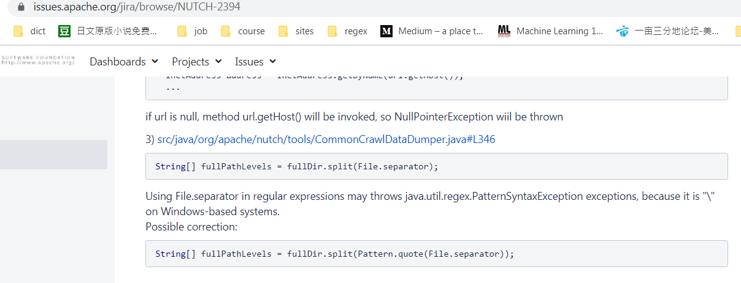
Compile Error (8 Bugs, 2%)
Regexes need to be tested!
Notes:
Another finding is related to compile erros.
While compile errors are not the most common issues, it is worthy to discuss because regexes exist in the code base even though they do not compile (click). I
n this example, split function requires a regex string (click), but File.separator is platform depedent, thus cause a compile error.
There are a lot of build tools on the software development such as Travis CI. These tools are not successful in catching these errors because the regex compile error are found during runtime.
The fact that regex compile errors can exist in the code implies that regexes are not tested. So definitely regexes need to be tested (click)
And it would better to test regexes earlier before they are introduced into the code base.

Slide 19
How are the issues fixed?
Notes:
Now we look at how deverlopers fix those regex issues. In our paper we list 10 common fix patterns. I am goiing to show you some of them.

Slide 20
Common Fix Patterns
Root Cause: regex itself, incorrect behavior, escaping literals (too permissive regex)
Fix: escape special characters
Before: regex = “.”
After: regex = “\\.”
Notes:
One of the fix patterns is to escape special character. For example, the character dot is escaped so that it will not be taken as a literal dot

Slide 21
Common Fix Patterns
Root cause: regex itself, design smell, unnecessary regex
Fix: replace the regex with non-regex solution
Before: if re.match( “.*error.*”, message):
After: if “error” in message:
Notes:
Sometimes when a regex is not necessary, we can just replace it with a simpler solution such as string operations. Here the regex matching is replaced by string contains
https://github.com/google/graphicsfuzz/pull/167
https://github.com/mozilla/Snappy-Symbolication-Server/pull/23

Slide 22
Common Fix Patterns
Root cause: regex itself, design smell, unnecessary regex
Fix: replace the regex with existing parser
Before: EMAIL_REGEX_PATTERN.matcher(email).matches():
After: import javax.mail.internet.InternetAddress;
InternetAddress emailAddr = new InternetAddress(email);
emailAddr.validate();
Notes:
In other times, regex are replaced with existing parsers. there exist special third party libraries to parse the certain type of strings Those strings could include email address, URL, and html context.

Slide 23
Common Fix Patterns
Root cause: regex API, code smell, unnecessary computation
Fix: add a guard to reduce number of executions
Before: Matcher m = Pattern.compile(regex).matcher(currentLine);
After: if(currentLine.contains(“error”)){
Matcher m = Pattern.compile(regex).matcher(currentLine);
}
Notes:
a common fix for performance issues was to reduce the number of regex execution by adding a guard statement
In the context of this example, if most of currentLine does not contain error, we don’t need to do the regex matching. Because regex matching has more overhead than string operations, adding the if condition here can improve the performance.
https://github.com/mozilla/treeherder/pull/61

Slide 24
And now the work begins!
Notes:
Now that we have characterized the issues in regexes and identified common patterns, the work begins by utilizing this study to create analyses, techniques and tools to prevent regex related bugs before they appear

Slide 25
Future Work
To regex or not to regex
Regex performance is about more than regex complexity
Regex compile errors are comparatively common
Notes:
There are a lot of work following this study.
In the study we observe that sometimes regex are replaced with string or third party operations, other times a regex is inserted in their stead. Further research is needed to understand when a regex should be used and when shouldn’t be used
This study leads to performance questions. When the regex complexity is superlinear and not O(n), it has the potential of ReDoS attack. But performance is not complexity
We found that regex performance issues are often tied to the number of executions rather than the regex complexity. The effectiveness of the performance fix patterns is not measured yet.
Given that compile error should not exist at all in the code base, the regex compile errors are comparatively common. How to automatically detect them before commiting them into the code base is another research problem to explore.
Much of this feeds into a need for testing.
More than 50% of the PRs do not contain edits to test code. Furthermore, compile issues with regexes were present, indicating a dire need for testing prior to committing code. Testing should focus on regexes outside the language as it is common to have overly restrictive regexes.

Slide 26
Thanks!
Peipei Wang (pwang7@ncsu.edu)
Notes:
There are a lot of findings and observations of this study. If you are interested, please check our paper. With this I will end my talk. Thank you all for listening.

Slide 27
Backup slides

Slide 28
Incorrect Behavior
Compile Error
Regular Expression Itself
Design/Code Smell
Incorrect Computation
Regex API
Design/Code Smell
New Feature
Other Code
Bad Smell
Other
Notes:
Three root causes emerged. (click)
These are the regular expression itself, the Regex API, and Other Code.
Each root cause manifested in two or three different ways. (click)

Slide 29
Why This Paper
Some people, when confronted with a problem, think “I know, I’ll use regular expressions.” Now they have two problems.
-Jamie Zawinski
Pros: concise, less code, and flexible
Cons: hard to read, write, and test
Notes:
http://regex.info/blog/2006-09-15/247 Jamie Zawinski (an early Netscape engineer) looks like a No to use regex
we love it, and hate it. But we cannot get rid of it
Succinct for pattern matching.
Less code and flexible
Hard to make it correct.
Complicated to understand.
Difficult to test and debug.

Slide 30
Why This Paper
Comprehension
Testing
Security vulnerability
Generalization among languages
Performance
Regex vs its alternatives
...
Notes:
glad that researchers have make efforts and addressed some of those problems

Slide 31
Why This Paper
How often they appear?
Which problem is more important?
What problem is not studied yet?
How to fix them?
...
Study them all together
Notes:
Each problem is a separate piece, we do not know how often each problem appears, which one is more important, and what is still in the box. And most importantly, who to fix them
that’s why we want to conduct this study, directly from the
Knowledge about the frequency of various types of regular expression issues, such as those related to performance, API misuse, and code smells, can guide testing, inform documentation writers, and motivate refactoring efforts. This work aims to uncover the nature of the issues that relate to regular expressions, and in particular, the nature of the issues that developers end up addressing.

Slide 32
Methodology
664 merged GitHub PRs from four communities: Apache, Mozilla, Google, and Facebook
350 (52.7%) PRs are identified as regex-related: changes (add, remove, edit/modify) to a regex or a regex API method
356 independent regex bugs
Notes:
data: why merged github
large/representative/mature/

Slide 33
Research Questions
Characteristics of the problems being addressed in regex-related PRs?
root cause of the regex bugs
manifestation of the regex bugs
Characteristics of the fixes applied to regex-related PRs?
Notes:
data: why merged github

Slide 34
RQ1: Regex Bug Characteristics
Root Cause | Manifestation | Count (%) in Manifestation | Count (%) in Root Cause
Regex | Incorrect Behavior | 165 (75.7%) | 218 (61.2%)
 | Compile Error | 8 (3.6%)
 | Bad Smells | 45 (20.6%)
Regex API | Incorrect Computation | 6 (22.2%) | 33 (9.3%)
 | Bad Smells | 27 (81.8%)
Other Code | New Feature | 59 (56.2%) | 105 (29.5%)
 | Bad Smells | 19 (18.1%)
 | Other Failures | 27 (25.7%)
Bad smells are symptoms that something may be wrong in the system design or code.
Notes:
Regular expression is still the dominant cause of regex problems but new root causes:
bad smells: code smells + design smells --- Martin Fowler refactoring
Compile errors occur in eight of the PRs, representing 2.2% of all regex-related PRs we studied; considering the severity of compile errors in terms of disrupting the program execution, this is worth noting.

Slide 35
RQ1: Regex Bug Characteristics
Example 1 of Bad Smells
(root cause: regex; manifestation: code smells/ performance issues)

Slide 36
RQ1: Regex Bug Characteristics
Example 2 of Bad Smells
(root cause: regex API; manifestation: code smells/Unnecessary computation)

Slide 37
RQ1: Regex Bug Characteristics
Regex performance is about more than regex complexity
22: 10 (regex) + 12 (regex api)
2 out of the 10 performance issues caused by regex itself is about complexity (i.e. ReDoS)
Notes:
demonstrated an interest in optimizing regex execution by refactoring the surrounding code (e.g., adding conditional or null checking, Patterns 8 & 10, Table 4) or by fine tuning the features in the regular expression representation such as changing capturing groups to non-capturing groups

Slide 38
RQ1: Regex Bug Characteristics
Example 3 of Bad Smells
(root cause: regex; manifestation: design smells/unnecessary regex)
Example 4 of Bad Smells
(root cause: other code; manifestation: other failures)

Slide 39
RQ1: Regex Bug Characteristics
To regex or not to regex
15 cases regex is regarded not proper and should be replaced
9 cases regex is regarded proper to use and replace other code
Notes:
15 PRs think regex usage is not proper replacing regex with string operations and 9 PRs of replacing string operations with regular expressions. When other code is the root cause of the issue, regexes are added in 82.9% (87/105) of the PRs
replacing vs replaced
more research on this problem
Regexes are added in 82.9% (87/105) of the PRs caused by other code

Slide 40
Other Findings
Developers do care about regex representation
Code smells of deprecated regex API and exception handling
Language-particular regex bugs
10 patterns of regex bug fixes
...
Notes:
Please check our paper if you are interested

Slide 41
Key Takeaways
A spectrum of regular expression bugs with varied root causes and manifestations
Regex usage depends on the source code it runs, are influenced by the software evolution and the code quality
Thanks
Peipei Wang (pwang7@ncsu.edu)

Slide 42
Incorrect Computation
Regex API
Design/Code Smell
New Feature
Other Code
Bad Smell
Other

Slide 43
Incorrect Behavior
Regular Expression Itself
Compile Error
Design/Code Smell

Slide 44
